Slide 1
Review of Class 1
Hierarchy of federal law: Constitution → Statutes → Administration
Sources of interpretive guidance for the Constitution: Text, Structure, Historical Practice/Understanding, Purpose
Used Articles I-III to show how technical readings of text may lead to legally unsound answers
Elements of legislative history

Slide 2
Why Understanding the Administrative State is Critical for Lawyers
(1) Agencies enact more binding rules of conduct than Congress.
(2) Agencies adjudicate more disputes than all the federal courts combined.
(3) The annual cost of compliance with federal regulation has been estimated at $1 trillion, which is about 1/10th of gross domestic product.

Slide 3
A Democratic Puzzle?
Why doesn’t Congress routinely enact measures that track the sometimes overwhelming majority of public opinion?

Slide 4
Complications: Senate
Senate practice for most bills permits unlimited debate
Vote to end debate = cloture
Impeding the end of debate = filibuster
Under Senate rules, cloture takes 60 votes (only majority for reconciliation bills, votes to confirm executive branch appointees and judges/Justices)

Slide 5
Complications: House
Legislation called to the floor under rules specific for each piece of legislation
Rules Committee dominated by loyalists of majority party leadership – can stop bills from getting to the floor even if majority of House would support
Under GOP in recent Congresses, no bills got to floor unless supported by a majority of GOP reps (“Hastert Rule”)

Slide 6
Some Critical Features of Legislative Process
Obstacles to legislating designed to encourage deliberation, allow input from multiple constituencies
Importance of norms – customary modes of interaction not enforceable by rule
Multiple sources of incentives for legislators
  Policy preferences
  Impact on leadership, reelection prospects
  Pressure for party loyalty
  Availability of bargains
Importance of “collective action problems”

Slide 7
“Logic of Collective Action”
Legislation tracks influence of well-organized groups
More difficult to organize large groups with diffuse interests than small groups with intense common interests
[But how, then, to explain environmental laws, civil rights laws, safety laws?]

Slide 8
“Vetogates”
Committee chair holds the most power; can refuse to assign to a subcommittee, refuse to hold a hearing, or assign to a hostile subcommittee.
Floor scheduling – can get low priority
Floor consideration – Senate filibuster
Refusal of either House to adopt the conference version
Presidential veto

Slide 9
How Party Discipline Works in the House
Leadership controls the agenda through the Rules committee
House has 3 competing proposals on Policy X, C, M, and L
With GOP or Dems in control, neither most conservative R’s or most liberal D’s have a majority
But party moderates will support leadership rule preferences rather than forming interparty coalitions – why?
  Strong norm of supporting special rules
  Cost of going along < Cost of dissent
  Party leadership rewards loyalty

Slide 10
Greater Complexity in the Senate
Foundational Problem: Standing rules provide no limit to debate – creates opportunities for filibuster
Workarounds:
  Cloture votes
  Unanimous consent agreements
Filibusters may frustrate the majority, but work to the benefit of moderates
  Allows Senators to vote for things they know will not pass
  Allows majority “dissenters” to vote “No” when it does not matter
Senate abolished filibusters for all POTUS nominations

Slide 11
Budget Process
Appropriations and Authorizations
Concurrent Budget Resolution (can’t be filibustered, not sent to President)
  Directs committees to
    Change spending (outlays) by specified amounts over a specified time;
    Change revenues by specified amounts over a specified time; or
    Raise or lower the public debt limit by a specified amount.

Slide 12
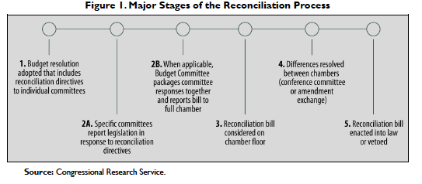
Reconciliation Process

Slide 13
Content of Legislation
Reflects Multiple Inputs
Voters
Executive branch personnel
Congressional committee staff
Lobbyists
Legislative counsel
Press
. . . Who also may or may not reflect popular majorities

Slide 14
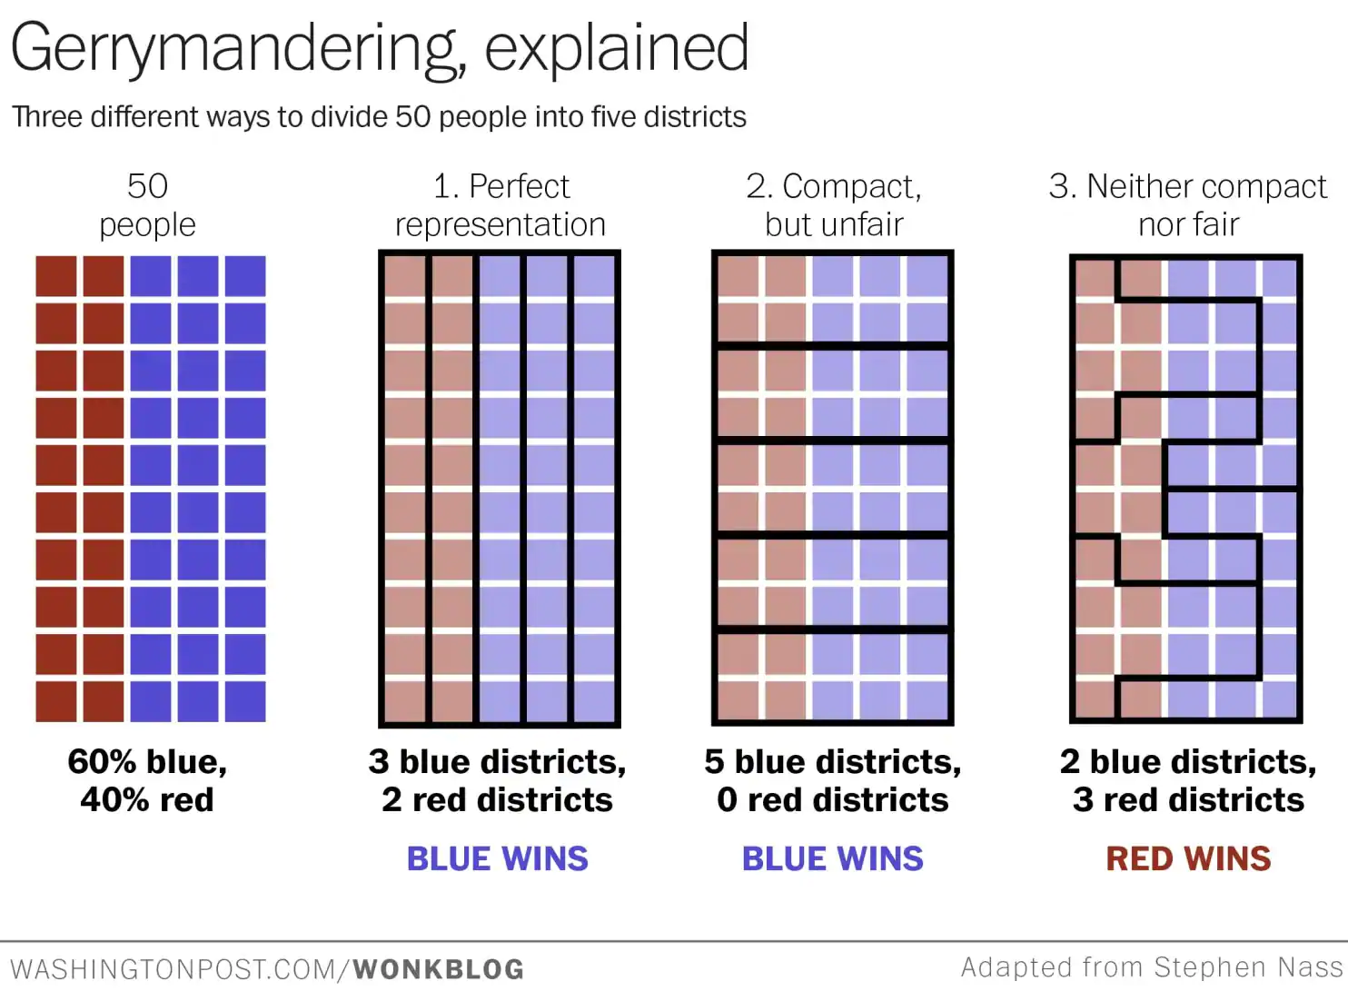
Gerrymandering

Slide 15
“Political Questions”
Textually committed to another branch
Lack of discoverable and manageable standards
Involves policymaking at the threshold of a kind that is nonjudicial
Lack of respect for other branches
Need for adherence to prior political decisions
Potential for embarrassment from contradictory opinions

Slide 16
Examples?
Is tax bill unconstitutional because House impermissibly allowed Senate to vote first?
Did President lawfully withdraw from a treaty?
Was a bombing attack on [insert nation] in retaliation for that nation’s involvement in a terrorist plot that resulted in U.S. military casualties constitutional?
Did President impermissibly receive [Insert name] as an ambassador from [country], thus conferring undeserved diplomatic immunity?
Was a Senate impeachment trial that ousted a federal judge from office unconstitutional because the evidentiary hearing was held by a committee, not the Senate as a whole?

Slide 17
Rucho v. Common Cause (2019)
Extreme differences between composition of state’s votes for Congress and seats won
  NC: Ds and Rs split vote 50/50, but Rs got 9/12 seats
  MD: Vote splits 65% D, 35% R, but D’s get 7/8 seats
No doubt about motivation: Statements by GOP redistricting chairs in NC and Dem governor in MD

Slide 18
Why a Political Question?
Majority
  Without a baseline notion of fairness, there is no manageable way to determine how much is too much, constitutionally speaking – no “limited and precise standard that is judicially discernible and manageable”
  Voters have recourse to Congress, to state courts, and to state initiative processes

Slide 19
Majority Argument
Partisan gerrymandering claims presuppose a norm of proportional representation
Uncertain if goal is overall competitiveness of districts, representative shares of total seats, adherence to traditional districting criteria
Uncertain how much deviation from the ideal is permissible, even when ideal is chosen
Disdains comparison to reapportionment, racial gerrymandering claims

Slide 20
Kagan Dissent
Extreme gerrymandering violates voters’ individual rights
  Dilutes votes in violation of 14th Amendment
  Violates associational rights under 1st Amendment
Adjudication would be routine—need to assess: Intent, Effects, Cause
Alternative sources of relief illusory
  Not all states have initiative
  Elected beneficiaries of gerrymandering won’t reform it
  If state courts can remedy, then judges must have manageable standards available to them

Slide 21
Dissenters in Earlier Cases
Offering Standards
Stevens: If district shape is bizarre and no neutral justification can be offered by way of explanation, scheme is unconstitutionally irrational and based on impermissible motive
Souter (with Ginsburg) – prima facie case
  P part of cohesive political group
  Traditional districting criteria ignored
  Deviation from traditional criteria produced packing or cracking in P’s district
  Alternative plan available with better outcome
  Packing or cracking was intentional

Slide 22
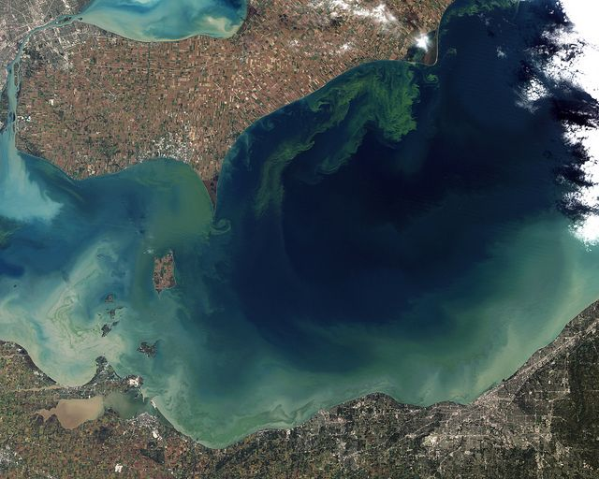
Photo Credit: NASA Earth Observatory

Slide 23
Causes and Harms of Algal Blooms
Causes
Harms
Agricultural Runoff: Excess crop fertilizers and livestock manure from farm fields into local streams and rivers that empty into the lakes.
Urban and Suburban Sources: Lawn fertilizers, sewage overflows, and failing septic systems add more nutrients to the water
Climate change; invasive species
Dangerous to public health
Destroying vital habitats and breeding grounds for birds, fish, and plants on which they rely
Decrease property values
Hurt tourism and recreation

Slide 24
First Regime of U.S. Government Regulation Was the Common Law
Could affected parties enter into contracts with culpable polluters to pay for injuries?
Would tort suits by persons injured by the algal bloom eliminate the negative effects or at least make them manageable?

Slide 25
Limits of Tort Law
Only incentivizes change to avoid harms that would elicit lawsuits
Retrospective v. prospective?
Reactive v. proactive?
Uncertainty
Institutional competence of courts
Political accountability
Parties v. Interested Participants
Collective action problems

Slide 26
Potential Normative Arguments in Support of Particular Regulations
Market forces do not require parties who can inflict harm to internalize the cost of the harms they cause (negative externalities)
  Information asymmetries
  Barriers to free competition (market concentration)
Promoting public goods
Eliminating social subordination of groups
Intergenerational equity
Protect public interest in some scarce resource
Values for their own sake
First successful national regulation: Steamboat boilers

Slide 27
Potential Normative Arguments Against Specific Regulations
Costs exceed benefits
Unfairness to regulated parties – too few paying the cost of benefits for all
Unintended consequences
  Impact on innovation?
  Barriers to new entrants?
Disputes over underlying values
Regulatory choice not rational or not adopted through fair procedure

Slide 28
Normative v. Descriptive Explanations
Potential justifications in principle for adopting regulation ≠ Explanations for why regulation is adopted
Normative Account = analysis of why something should or should not happen
Positive or Descriptive Account = analysis of why something is or is not likely to happen

Slide 29
Going Beyond Tort Law
Legislatures frequently persuaded, given limits of common law, to regulate political, social, economic activity to advance social goals, including increasing safety, protecting public health, eliminating unjustified discrimination, protecting natural environment, promoting integrity of markets.
But “Should there be a regulation?” ≠ “Should there be a regulatory agency?”

Slide 30
The Path to Administration
Is there a problem warranting government response?
Would private law remedies suffice? (Liability rule + judicial enforcement at the behest of private parties)
Should legislature prescribe conduct rules?
Should an agency be put in charge?
What tools should it have?

